Slide 1

PhD Proposal
Understanding Vehicle-Bridge Interaction through Field Measurements and Model-Based Simulations
John B. Braley
Department of Civil & Environmental Engineering
School of Engineering
Rutgers, The State University of New Jersey
April 4, 2018

Slide 2
Research Need
State of US Bridges *
Majority approaching or exceeding design life
Traffic restrictions imposed on 10% (choke points)
$123 billion required
Stewardship Objectives
Continued performance of existing bridges
Improved performance of new bridges
Informed resource allocation
Required Knowledge
Realistic demands
Factors affecting performance
Bridge deterioration
* 2017 ASCE Infrastructure Report Card

Slide 3

State of Practice
Live load demands principally consist of truck loads
Static analysis prescribed
Dynamic component reduced to “amplification” factor
Question: Is this simplification adequate?
VS
m
m
m
m
m
m

Slide 4

Dynamic Amplification Factors
Static loads used in highway bridge design and evaluation
Amplification factors to account for additional load effect from VBI applied to loading model
Two Definitions:
$IM=\frac{Dynamic Response−Static Response}{Static Response}$
$DAF=\frac{Dynamic Response}{Static Response}$
$LL=\left(1+IM\right)∗R_{sta}$ or $LL=DAF∗R_{sta}$

Slide 5
Dynamic Amplification in Codes
Different countries use different factors
Range from 0.05 to 0.40 (AASHTO: 0.33)
Dependent on:
road roughness, no. axles, 1st natural freq, span length
Developed through surveys of existing bridge stock in the 1950s and 1980s
More recent experimental evaluations of IM’s
High variability
Not uncommon to exceed prescribed value

Slide 6
Shortcomings with Experimental Research
Many of the larger studies found bridges with amplification factors between 1.5 and 2, and have identified some of the most influential parameters
However:
Even the largest studies face the issue of whether the studied sample set is representative or comprehensive of the entire bridge population (e.g. Study of 200 bridges in Switzerland consisted mostly of concrete bridges)
Furthermore, the studies often consider too few parameters to fully understand the conditions resulting in amplification issues
These studies have failed to characterize the mechanisms that lead to large dynamic amplification and they offer no quantitative relationships

Slide 7
Shortcomings with Analytical Research
Analytical tools (simulation) provide the ability to investigate the mechanisms driving VBI and amplification. Several analytical studies have echoed the general conclusions of the experimental studies. (e.g. road roughness is a very important parameter)
However:
It is only recently, that software and computing power have made large scale simulation studies possible.
Therefore there is again the issue of small sample sizes and too few parameters investigated
Furthermore, there is little assurance the models are capable of modeling VBI and thus conclusions have been limited to qualitative relationships.

Slide 8
Knowledge Gaps & Vulnerabilities
Dynamic effect of traffic on highway bridges is poorly understood
Inadequacy of current codes has been demonstrated by field experiments (i.e. outliers)
Simulation studies on influential parameters have failed to reach actionable conclusions
Interdependency of influential parameters has been largely overlooked
Established methodologies were developed through statistical means
How has the bridge population changed?
How has traffic changed?
Can a dynamic factor adequately account for VBI?
Effect of truck platoons on highway bridges
Research on railway bridges suggests the repetitive loading of truck platoons can excite bridge dynamics and may lead to amplified bridge response
Notes:
Field experiments are limited to the population subset and only serve to demonstrate shortcomings, rather than propose improvements
Simulations have been mostly with simplified models (i.e. single-line girder),
and with only a few parameters to be investigated
and no assurance that the models are capable of simulating VBI

Slide 9
Objectives
Characterize the mechanisms behind VBI
Role of influential parameters
Identify any shortcomings with current design and assessment methodologies
In which situations are their treatment of dynamic amplification inadequate
Propose modifications
Identify bridge vulnerabilities associated with truck platooning
“Problematic” platoon patterns and vulnerable bridges
Make recommendations related to implementation strategies and policies
Notes:
Difference from previous studies:
Field testing and model calibration will ensure the models are capable of simulating VBI
All influential parameters will be examined simultaneously
Develop actionable conclusions

Slide 10
Inductive Research Strategy
Demonstrate Comprehensive Understanding of VBI
Phase 1 – Identify and characterize “test” structure through field testing. Develop FE model.
Phase 2 – Perform detailed characterization of VBI on test structure. Refine FE model.
Phase 3 – Investigate VBI mechanisms with sensitivity analysis of FE model parameters
Phase 4 – Assess capability of established methods to predict dynamic amplification with FE parametric studies
Phase 5 – Characterize vulnerability of bridges exposed to platooned trucks with FE parametric studies
Develop Actionable Knowledge of Live Load Demands

Slide 11
Research Strategy – Completed Work
Phase 1 – Identify and characterize “test” structure through field testing. Develop FE model.
Phase 2 – Perform detailed characterization of VBI on test structure. Refine FE model.
Phase 3 – Investigate VBI mechanisms with sensitivity analysis of FE model parameters
Phase 4 – Assess capability of established methods to predict dynamic amplification with FE parametric studies
Phase 5 – Characterize vulnerability of bridges exposed to platooned trucks with FE parametric studies

Slide 12
Research Strategy – Completed Work
Phase 1 – Identify and characterize “test” structure through field testing. Develop FE model.
Phase 2 – Perform detailed characterization of VBI on test structure. Refine FE model.
Phase 3 – Investigate VBI mechanisms with sensitivity analysis of FE model parameters
Phase 4 – Assess capability of established methods to predict dynamic amplification with FE parametric studies
Phase 5 – Characterize vulnerability of bridges exposed to platooned trucks with FE parametric studies

Slide 13
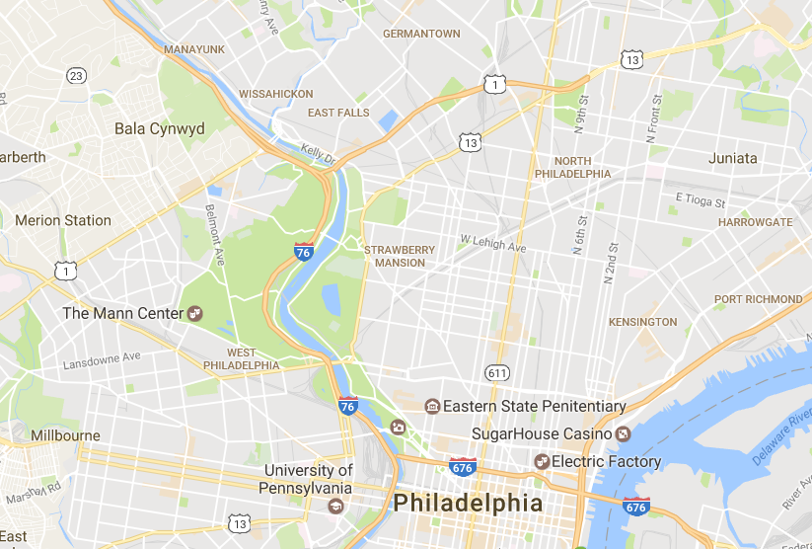
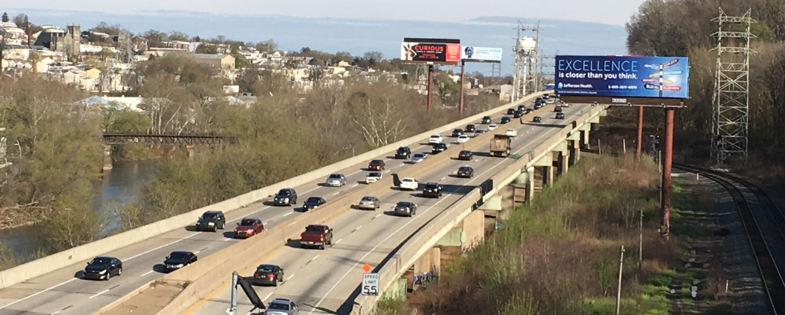
Completed Work – Phase 1
Characterize Bridge through StID
Observe structure and it’s behavior
Obtain frequencies and mode shapes
Construct and calibrate model
Interrogate FE model
I-76 PENCOYD VIADUCT (1986)

Slide 14
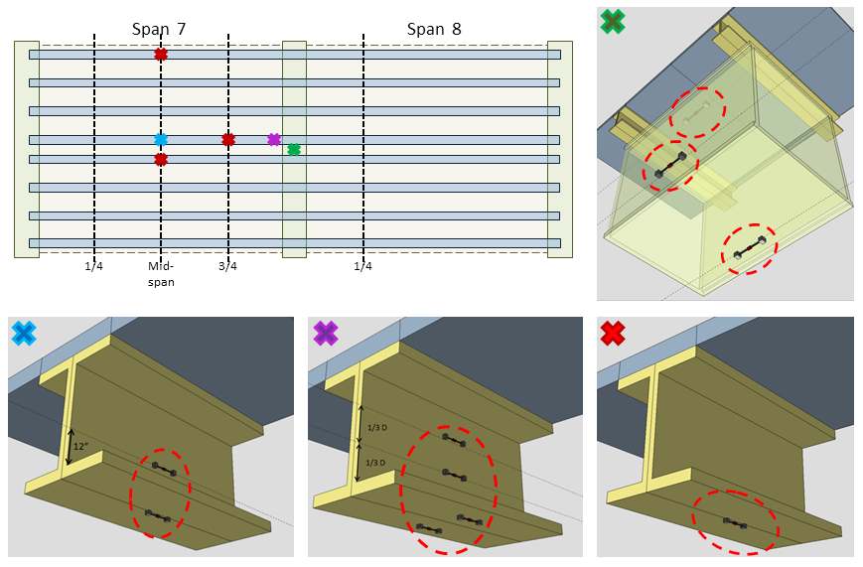
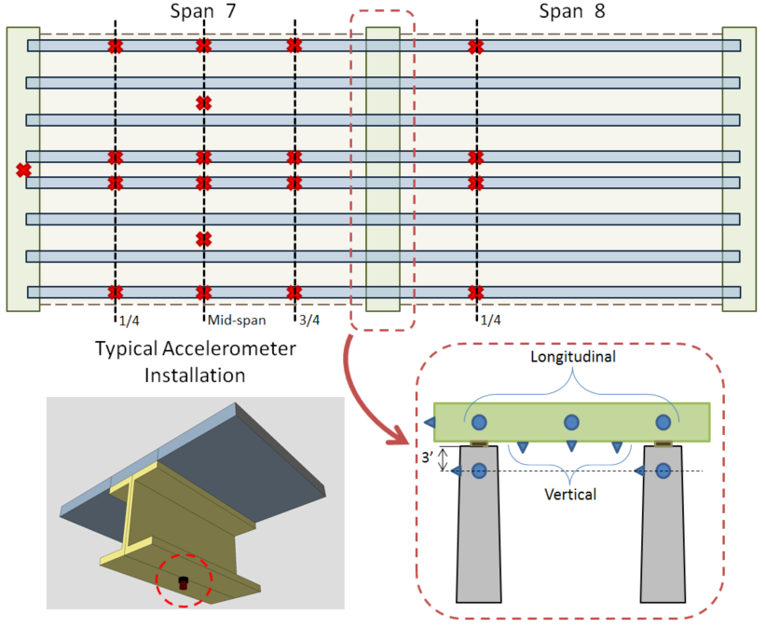
Completed Work – Phase 1: First Field Test

Slide 15
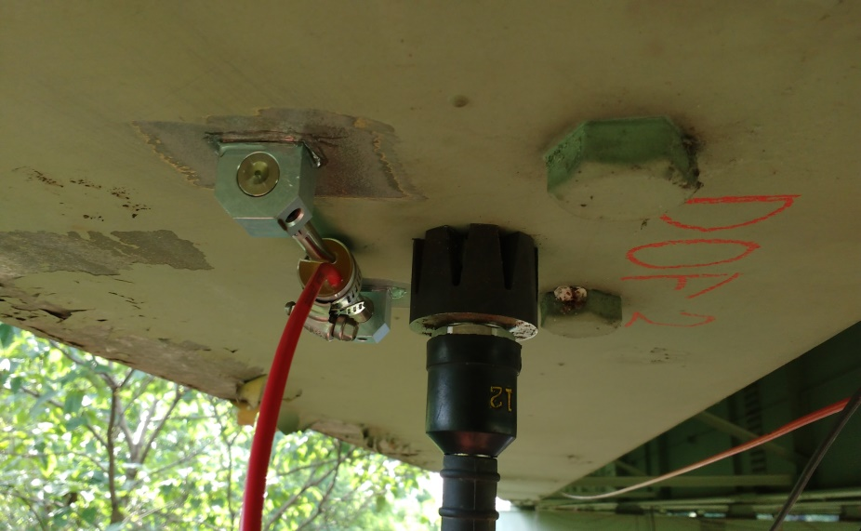
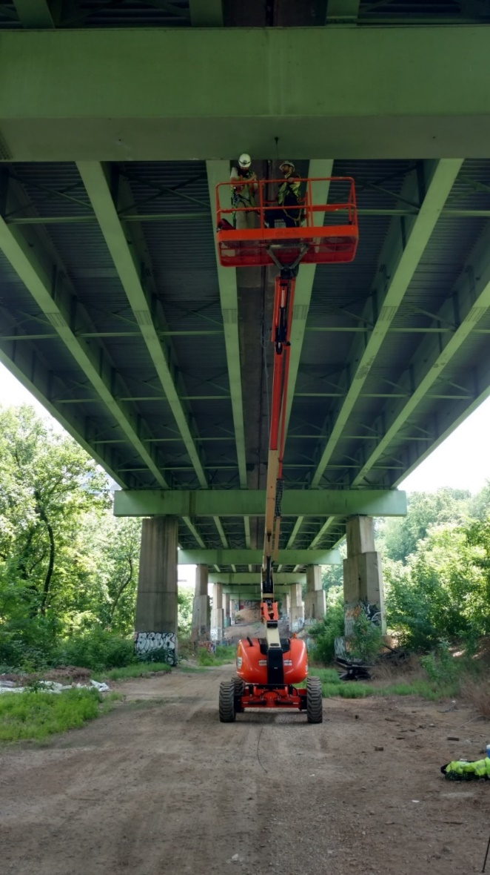
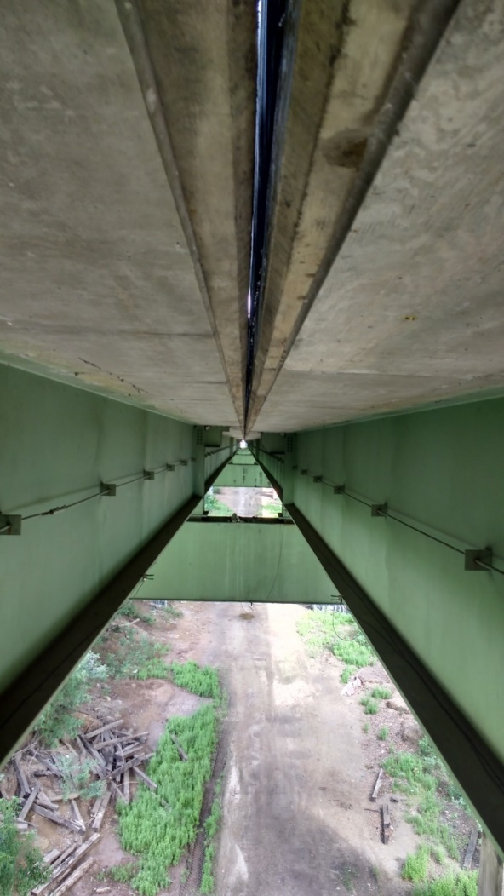
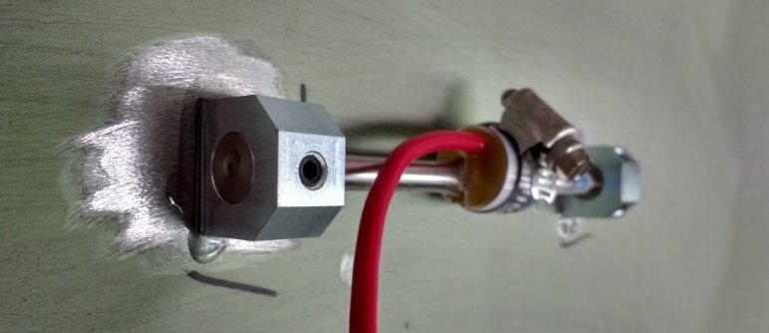
Completed Work – Phase 1: First Field Test
Spans 7 & 8 selected for testing
INSTRUMENTATION PLAN
30 Accelerometers
12 Strain Gauges
24 hours of data collected

Slide 16
Completed Work – Phase 1: Results
Primary objectives:
Mode shapes and frequencies obtained
FE model created and calibrated
FE model revealed no structural anomalies
Additional Observations
Dynamic behavior is consistent for different spans
Operational peak strains 100 - 200 με
Vibration levels as high as 25%G: “very disturbing” for human comfort criterion
Vibration results in large amplifications

Slide 17
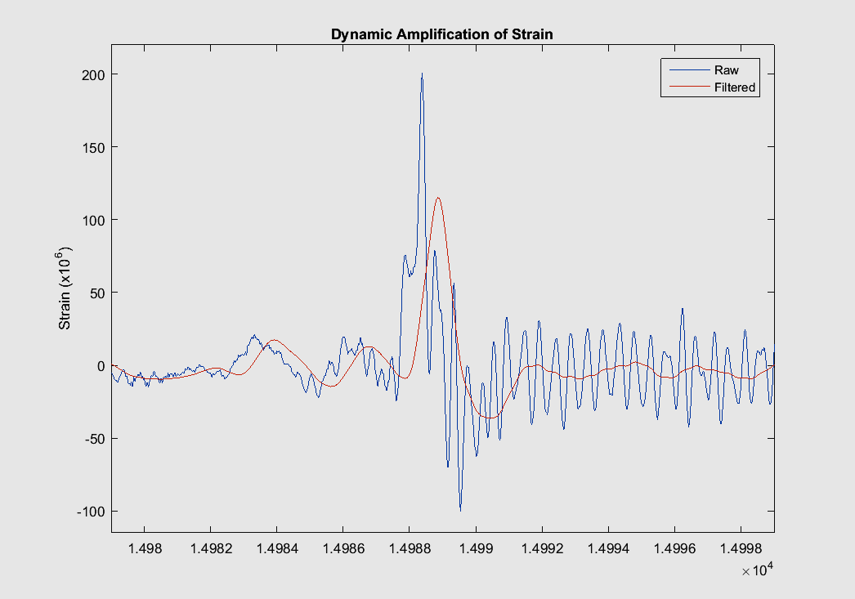
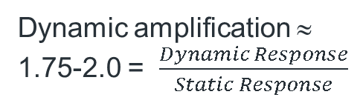
Completed Work – Phase 1: Outcomes
Dynamic amplification ≈ 1.75-2.0 = $\frac{Dynamic Response}{Static Response}$
Dynamic response
Static response

Slide 18
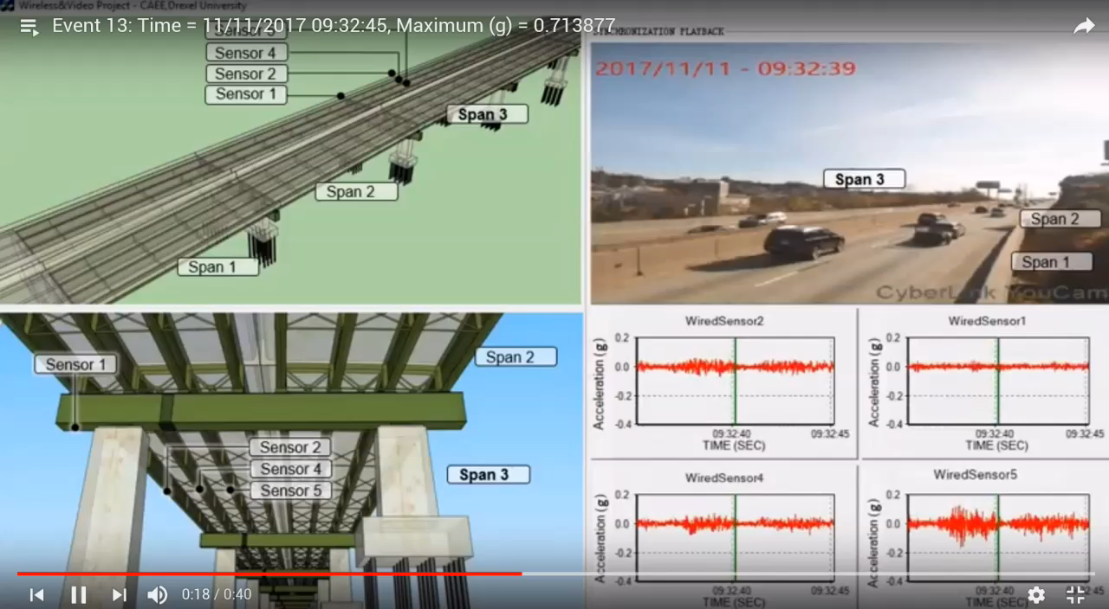
Completed Work – Phase 1: Outcomes

Slide 19
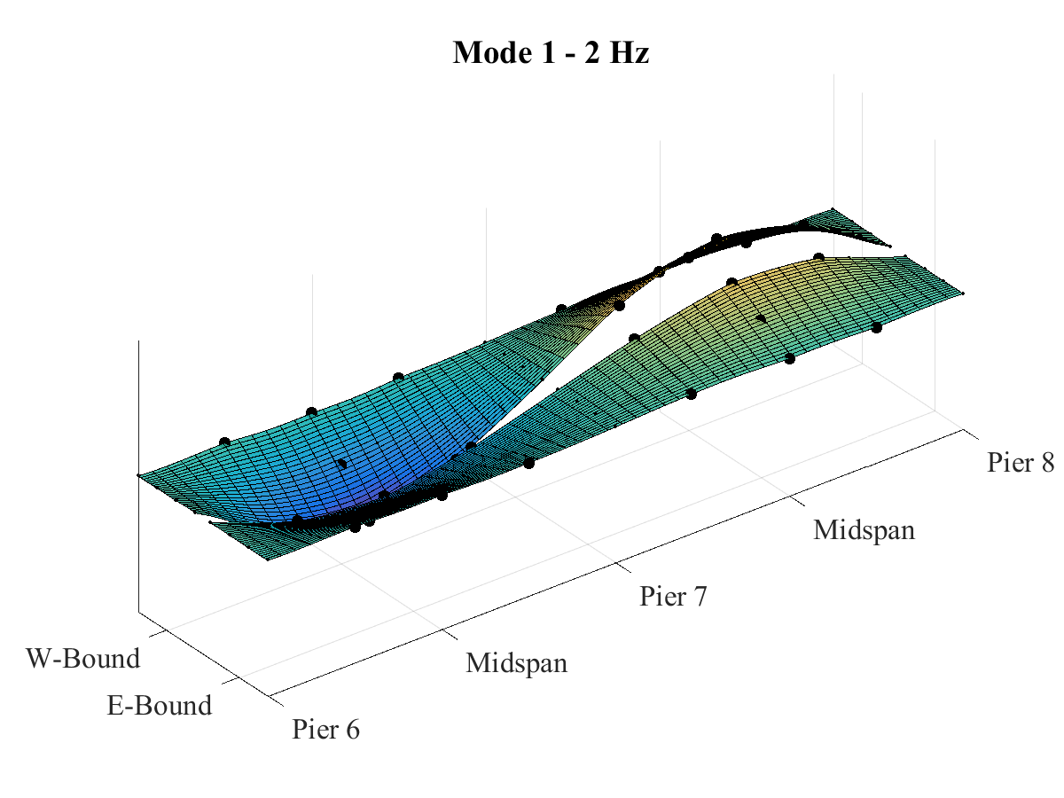
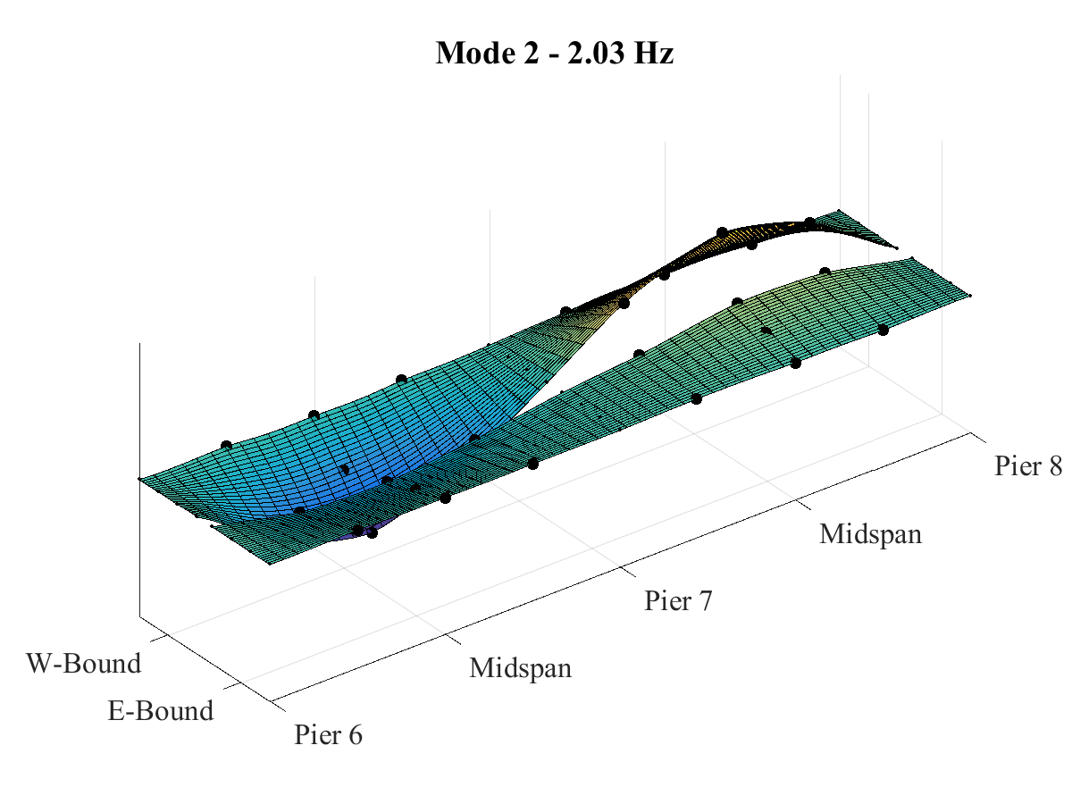
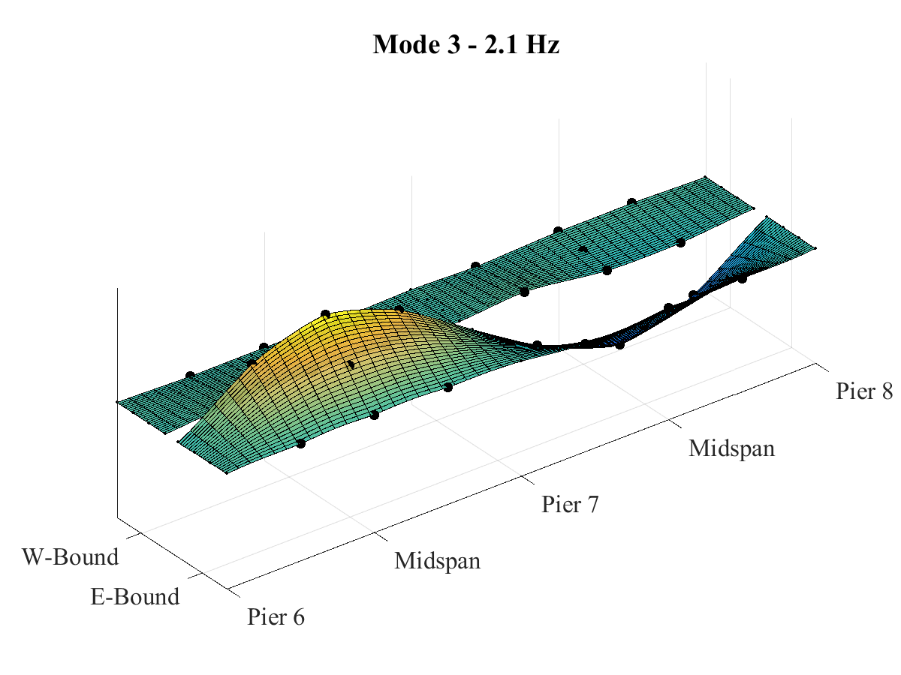
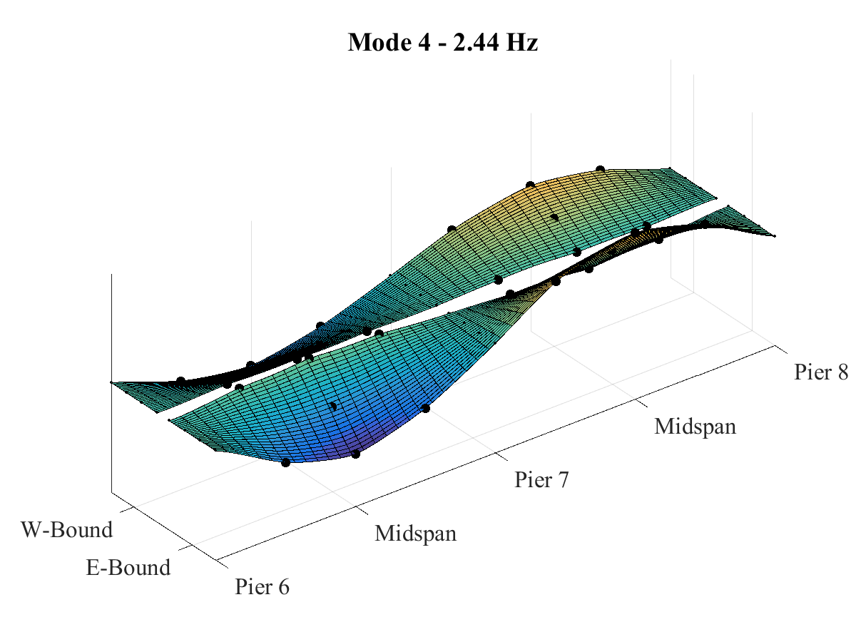
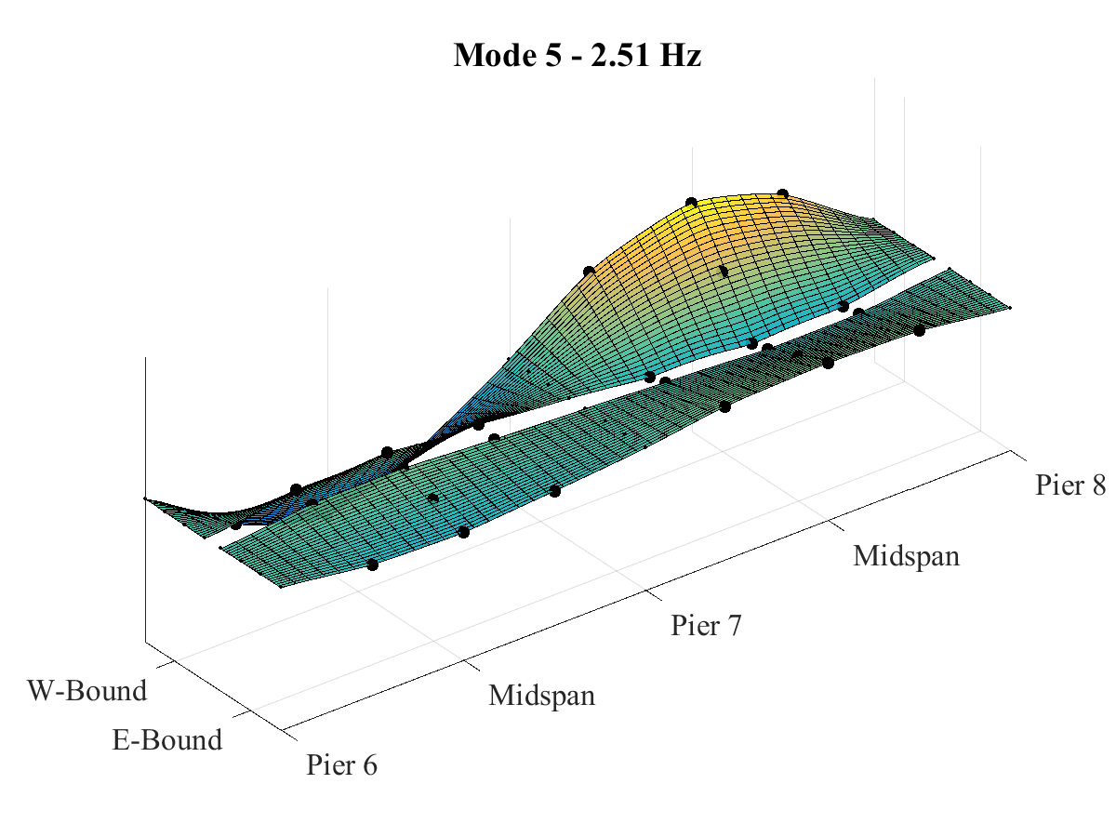
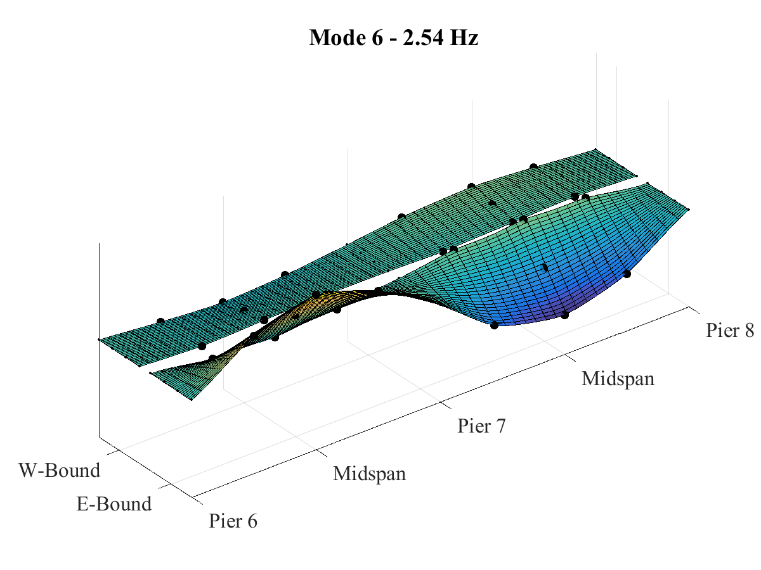
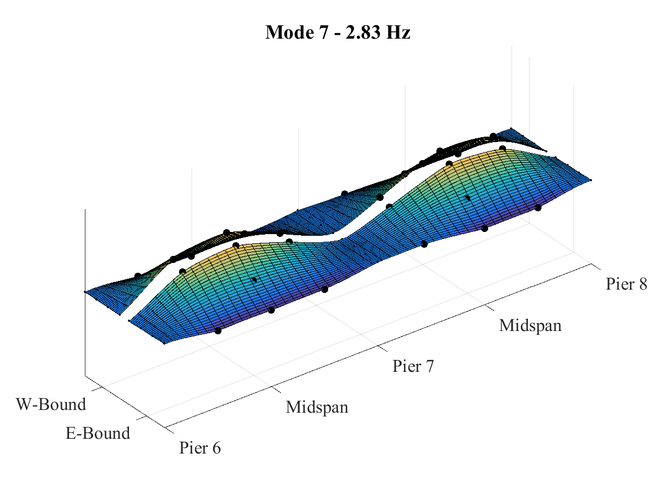
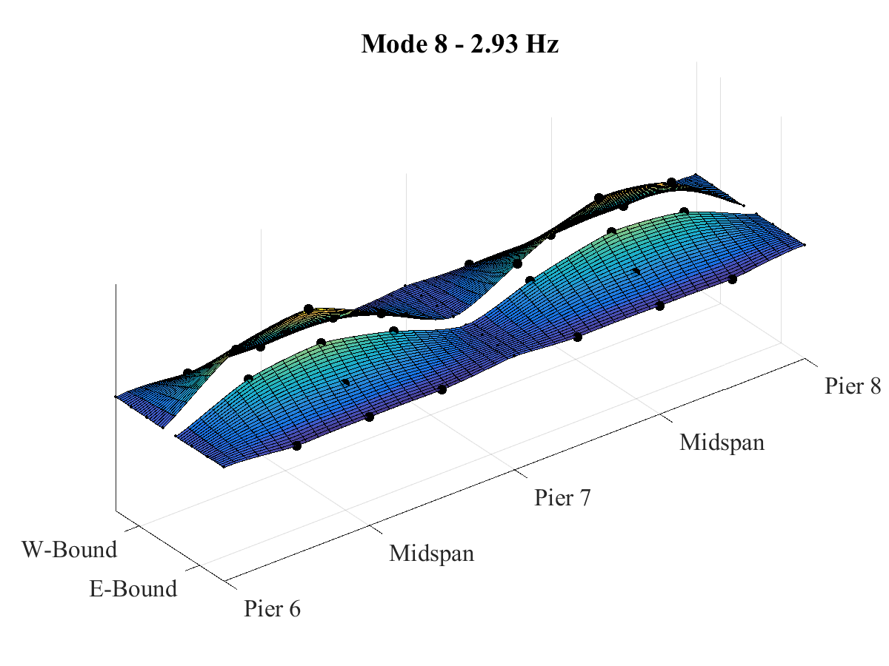
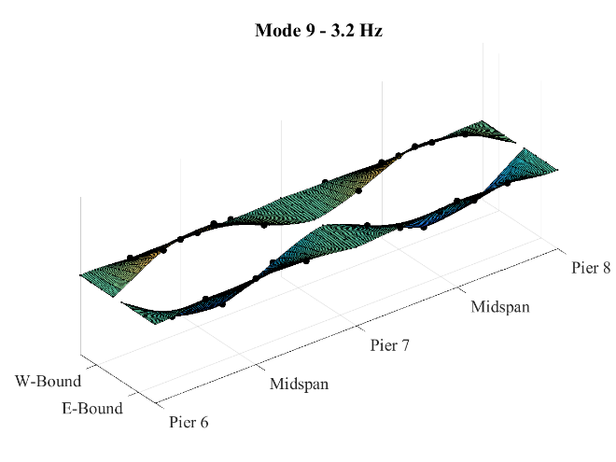
Mode Shapes

Slide 20
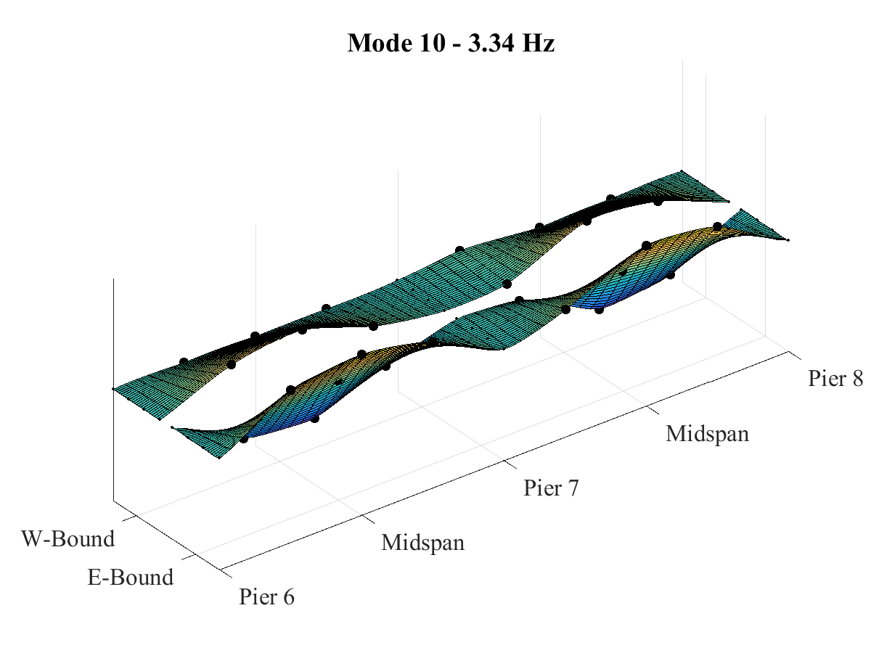
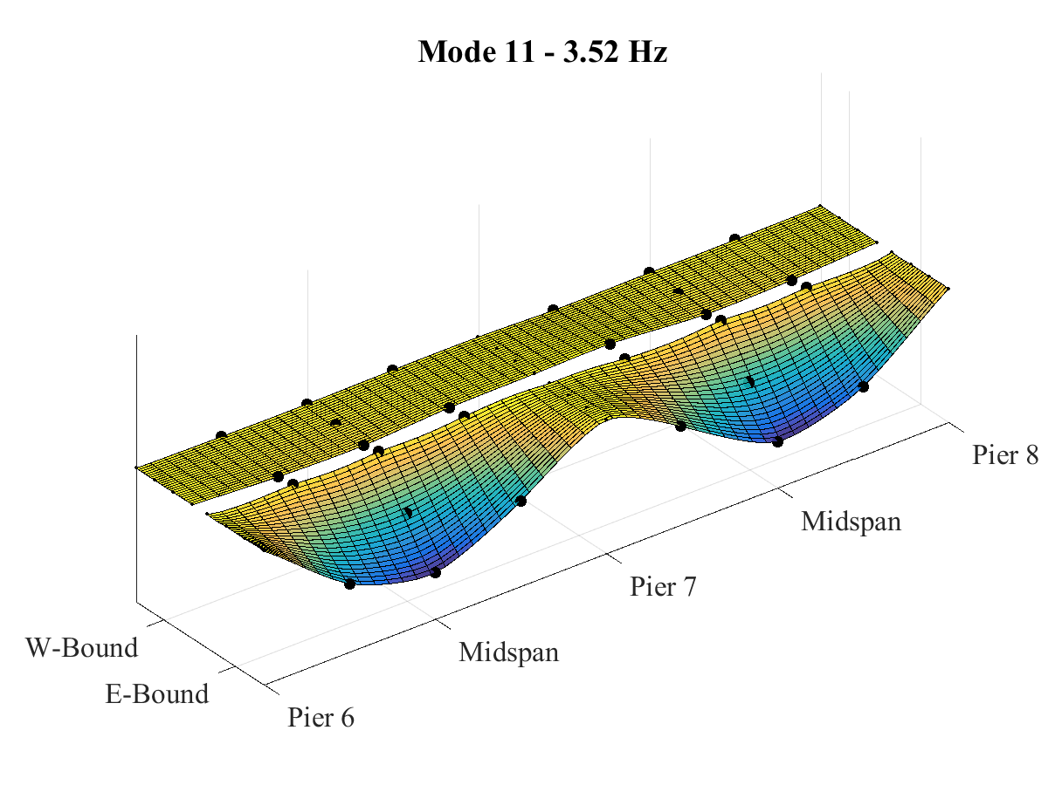
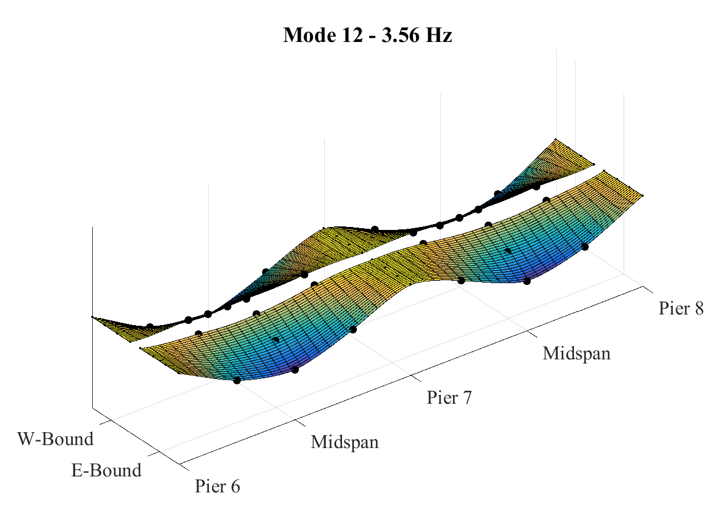
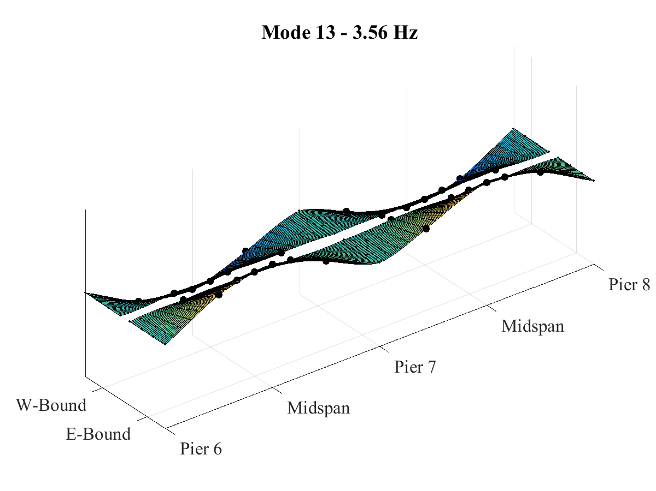
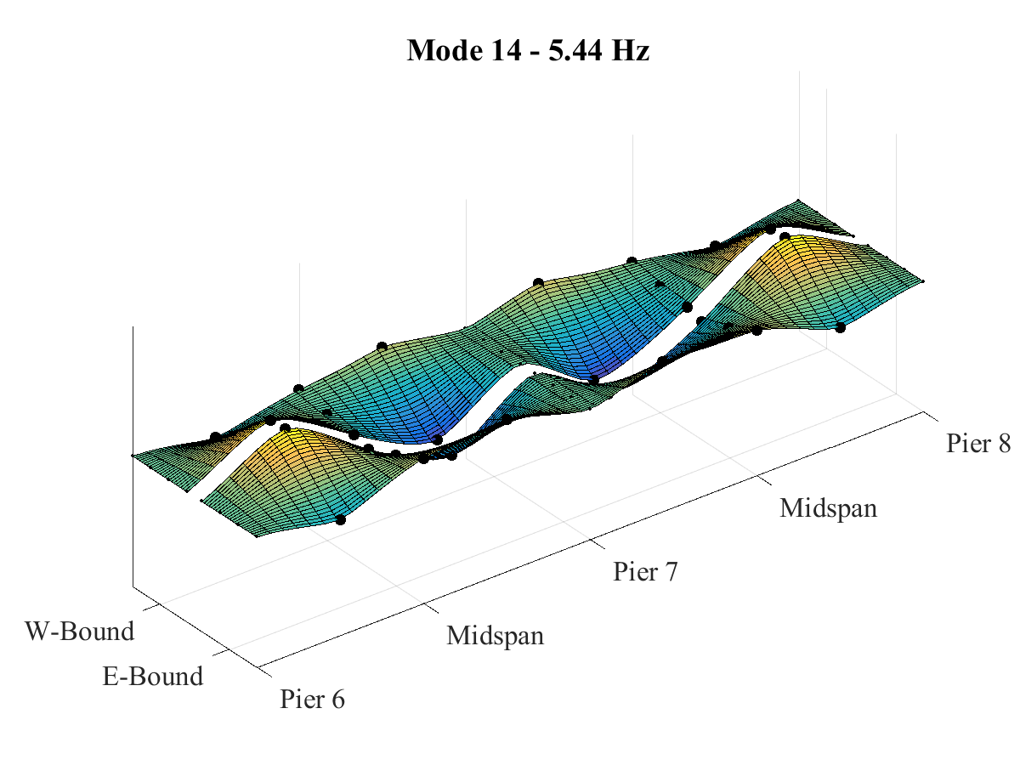
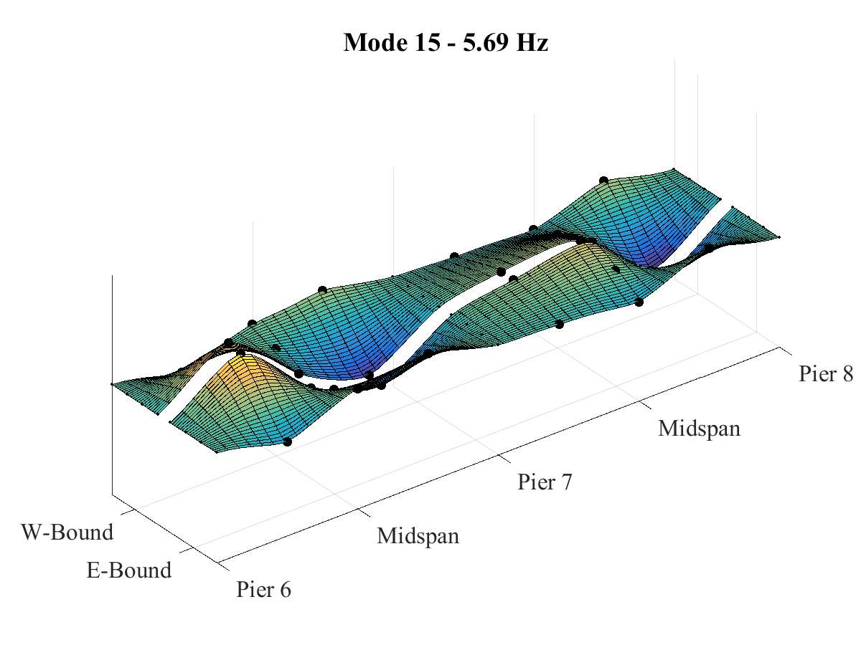
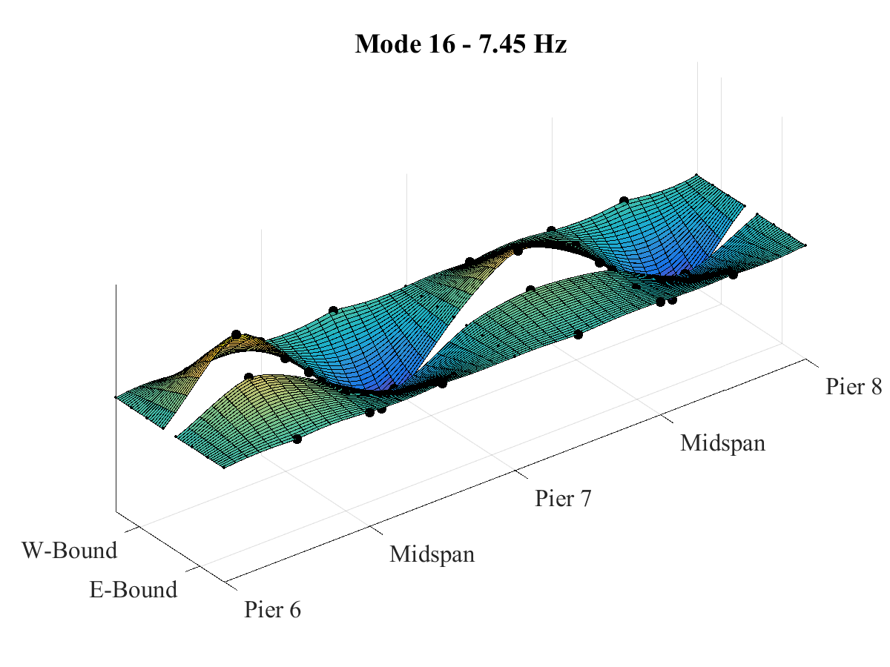
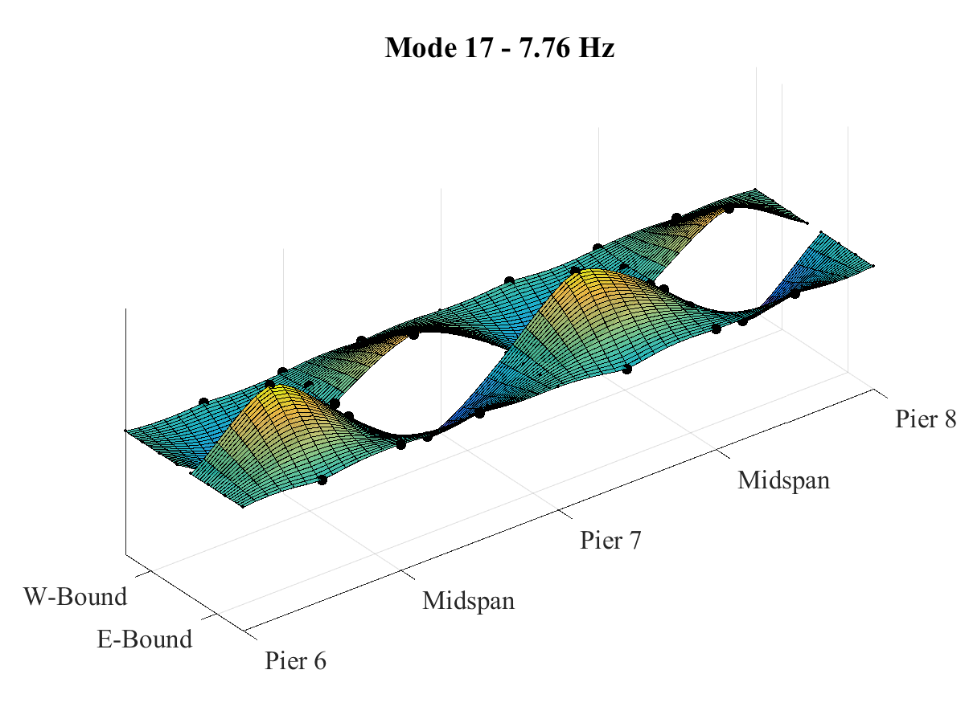
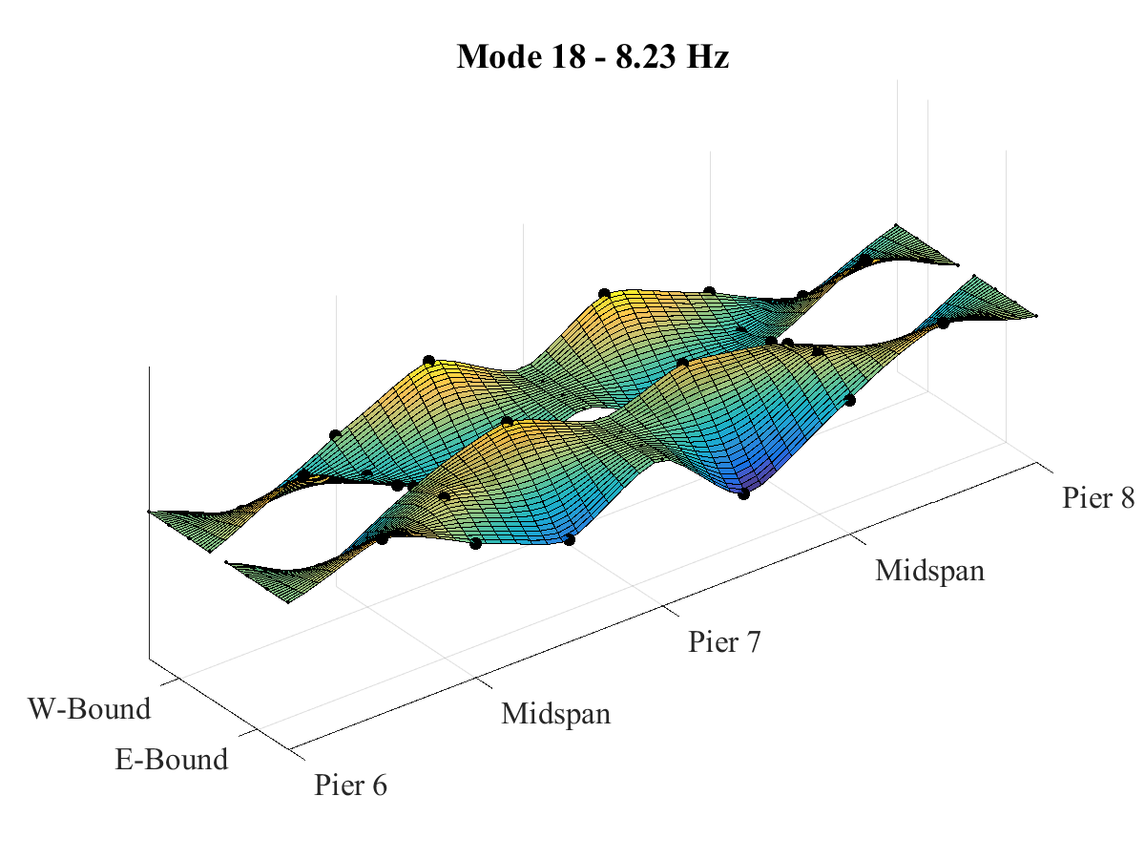
Mode Shapes

Slide 21
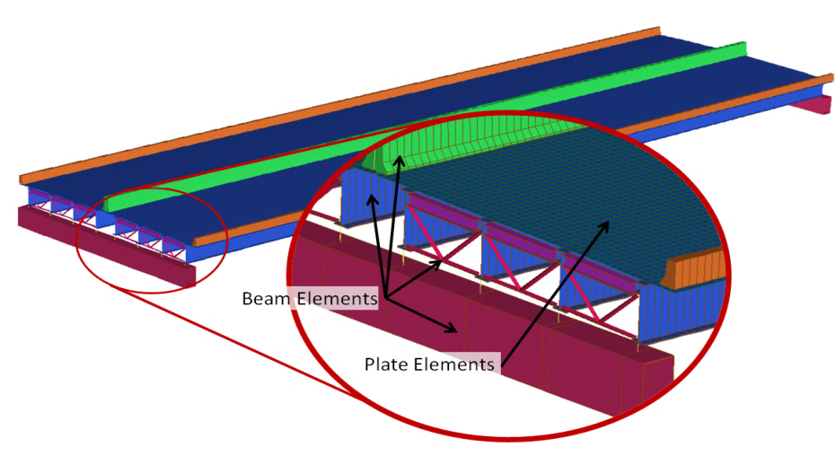
Completed Work – Phase 1: First Field Test
A 3D “Element-level” FE model of Spans 7 & 8 was constructed and calibrated
Deck material properties and barrier stiffness updated
Model required minimal adjustment from a-priori state
Refined load rating performed: >1.0
Bridge satisfies strength and serviceability limit states

Slide 22
Completed Work – Phase 1: Conclusions
The bridge is experiencing high levels of vibration
These levels can be categorized as “very disturbing”
The vibration is induced by passing trucks
The vibration is leading to amplification of strain in the girders
The FE model revealed no structural anomalies
The bridge satisfies “strength” limit states
Functionality, Fatigue, Serviceability

Slide 23
Research Strategy – Completed Work
Phase 1 – Identify and characterize “test” structure through field testing. Develop FE model.
Phase 2 – Perform detailed characterization of VBI on test structure. Refine FE model.
Phase 3 – Investigate VBI mechanisms with sensitivity analysis of FE model parameters
Phase 4 – Assess capability of established methods to predict dynamic amplification with FE parametric studies
Phase 5 – Characterize vulnerability of bridges exposed to platooned trucks with FE parametric studies

Slide 24
Completed Work – Phase 2: Test Objectives
Characterize Vehicle-Bridge Interaction
Capture motion of vehicle over bridge
Roll, pitch, bounce
In all lanes; at different speeds, traffic conditions
Capture resulting response of bridge
Acceleration and strain
At different locations along structure
Able to be synchronized with truck motion data
Recreate testing “scenarios” with FE simulation
Collect all necessary data/info for model creation

Slide 25

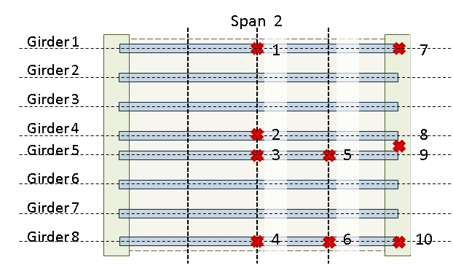
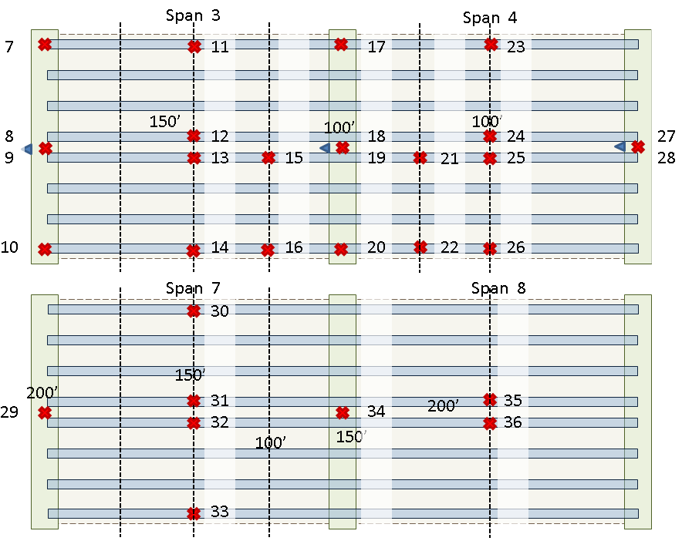
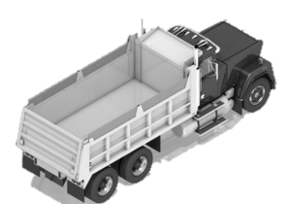
Completed Work – Phase 2: Detailed Field Characterization
Instrumentation Layout
Span 1
Span 2
Span 3
Span 4
Span 5
Span 6
Span 7
Span 8
Span 9
Span 10
Span 11

Slide 26
Completed Work – Phase 2: Test Execution
Instrumentation
Accelerometers (4) on 4 corners of dump body (sync)
Accelerometers (36) on spans 2, 3, 4, 7 & 8 (sync)
Strain gauges (2) on span 3
3 video cameras
Test Activity
14 passes were made by the test truck over the bridge
Truck velocity ranged from 10 mph to 60 mph
Both sides of the bridge and all 4 lanes were traversed
Passes were made in various traffic conditions (light traffic, medium traffic, heavy traffic)

Slide 27
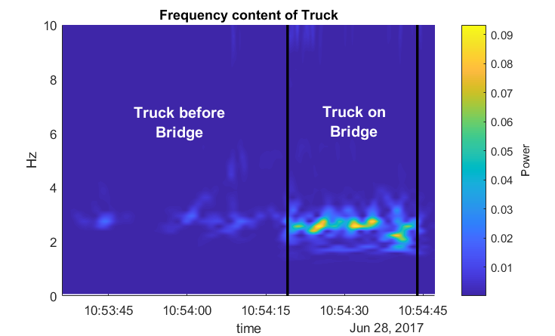
Completed Work – Phase 2: Test Observations
Off Bridge
The magnitude of truck’s acceleration greatly increases as soon as it enters the bridge
The truck’s first mode between 2 and 3 Hz is excited when traversing the bridge
Acceleration magnitude quickly drops after exiting the bridge

Slide 28
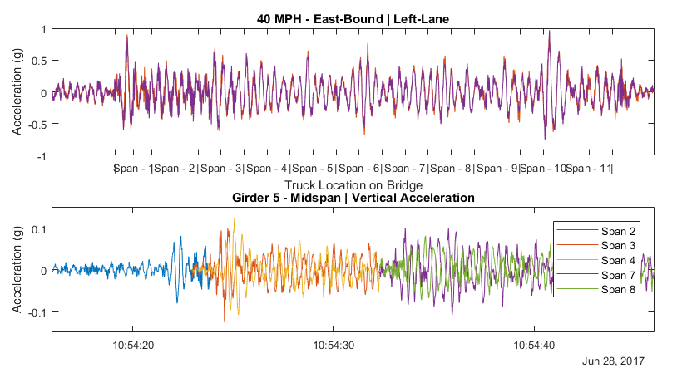
Completed Work – Phase 2: Test Observations
Span 1
Span 2
Span 3
Span 4
Span 5
Span 6
Span 7
Span 8
Span 9
Span 10
Span 11
Test Vehicle -

Slide 29
Completed Work – Phase 2: Test Conclusions
Observations from test data
The test truck was readily excited when traversing the bridge
Magnitude of truck acceleration increased with speed
Even a single truck can cause bridge vibration in excess of 10% G
Initial Simulation Efforts
Simulation unable to replicate magnitude of acceleration
Vehicle parameters, speed, structural parameters, camber, joints, etc.
Roadway profile must be included

Slide 30
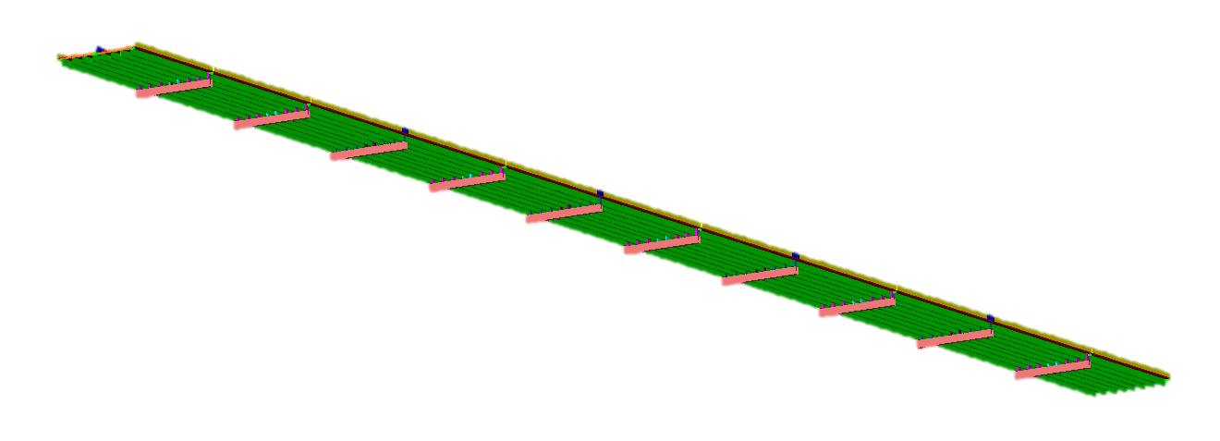
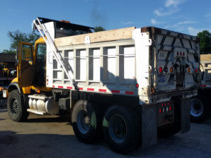
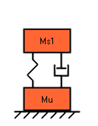
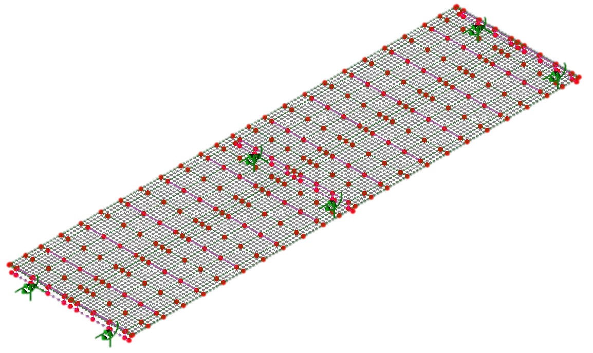
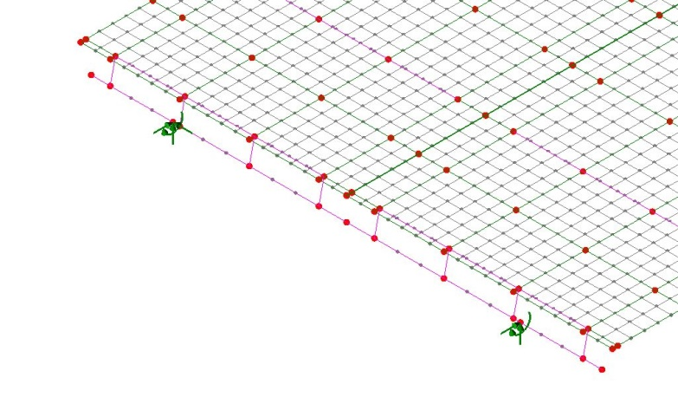
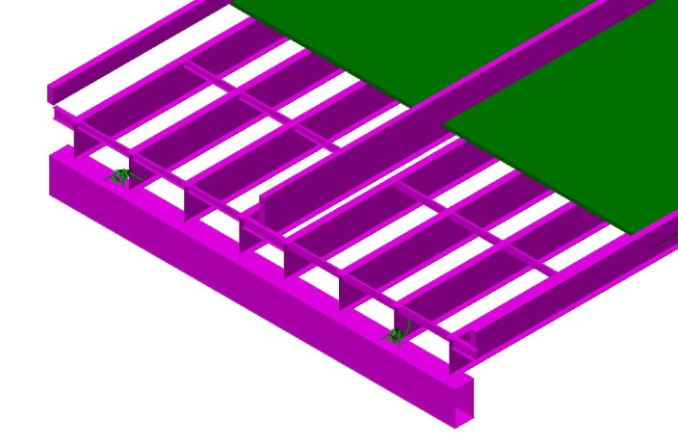
Completed Work – Phase 2: FE Simulation
Model Form: Hybrid Grillage
Updated Parameters: Barriers & Box Girders
Updated 2-span section before expanding to 11 spans
Truck modeled as sprung mass with damping
Truck model parameters calculated from measured mass and first natural frequency

Slide 31
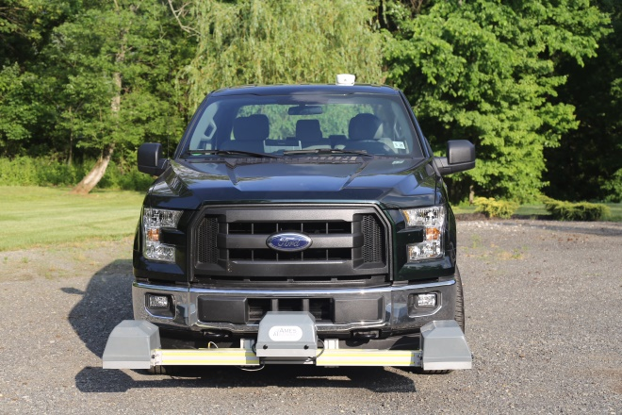
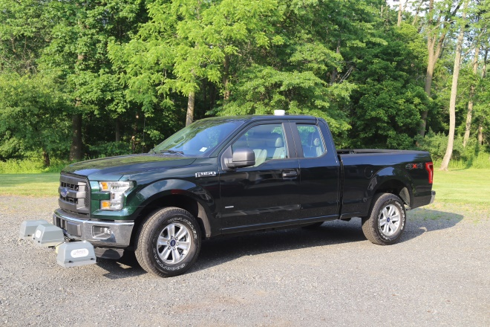
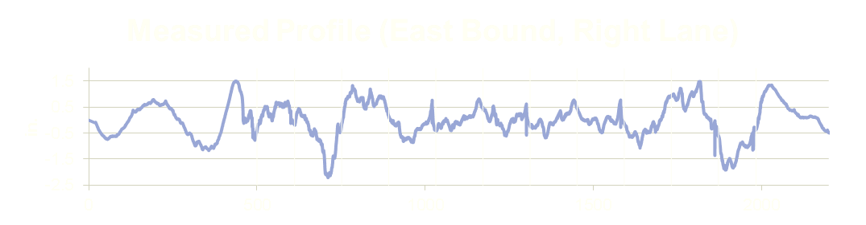
Completed Work – Phase 2: Detailed Field Characterization
The profile of the bridge was measured by RWS Consulting.
Ames Engineering Model 8300 Portable Profiler
2 passes in each lane
Captured left and right wheel lines

Slide 32
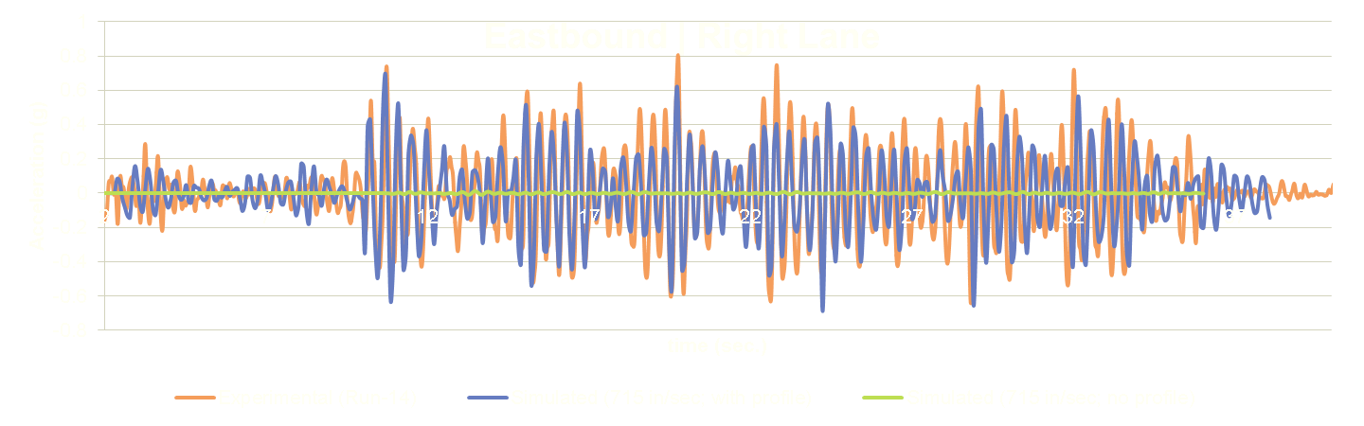
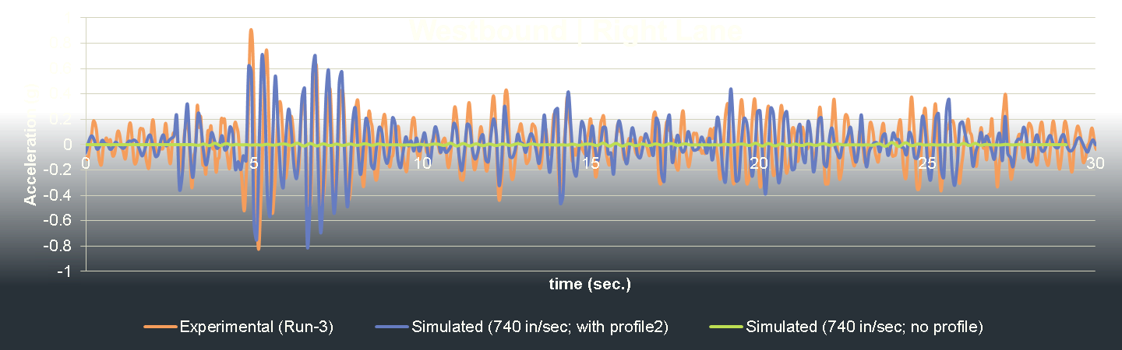
Completed Work – Phase 2: Simulation of test scenarios
Simulation vs Experimental - Truck Acceleration

Slide 33
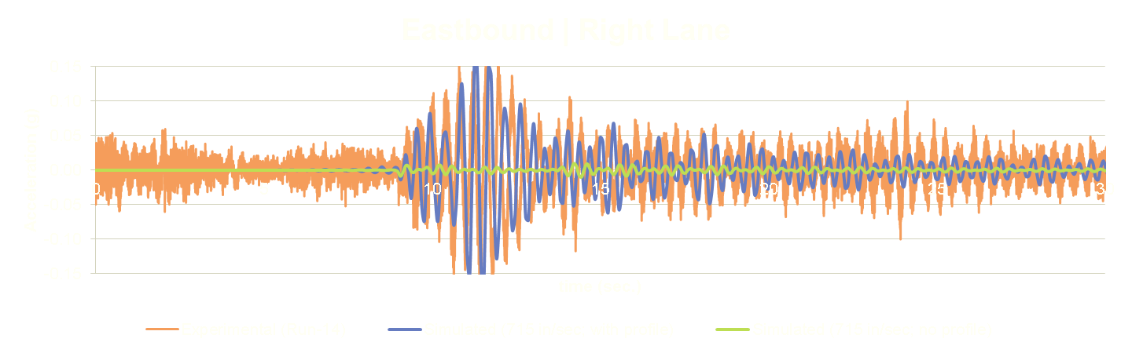
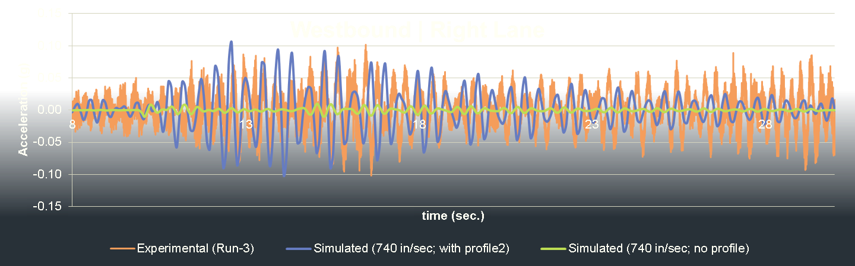
Completed Work – Phase 2: Simulation of test scenarios
Simulation vs Experimental – Bridge Acceleration
SPAN 3
SPAN 8

Slide 34
Completed Work: Summary
“Test” structure has been characterized through field testing, modal parameter identification, and FE model creation and calibration.
Monitoring of bridge and truck accelerations has revealed characteristic VBI behavior
Measurement of the profile was necessary for accurate simulation
An FE model has been developed that can replicate the characteristic accelerations and thus shown capable of simulating VBI

Slide 35
Research Strategy
Phase 1 – Identify and characterize “test” structure through field testing. Develop FE model.
Phase 2 – Perform detailed characterization of VBI on test structure. Refine FE model.
Phase 3 – Investigate VBI mechanisms with sensitivity analysis of FE model parameters
Phase 4 – Assess capability of established methods to predict dynamic amplification with FE parametric studies
Phase 5 – Characterize vulnerability of bridges exposed to platooned trucks with FE parametric studies

Slide 36
Objectives
Characterize the mechanisms behind VBI
Role of influential parameters
Identify any shortcomings with current design and assessment methodologies
In which situations are their treatment of dynamic amplification inadequate
Propose modifications
Identify bridge vulnerabilities associated with truck platooning
“Problematic” platoon patterns and vulnerable bridges
Make recommendations related to implementation strategies and policies
Notes:
Difference from previous studies:
Field testing and model calibration will ensure the models are capable of simulating VBI
All influential parameters will be examined simultaneously

Slide 37
Future Work – Phase 3: Identification of VBI Parameters
The FE model that has been shown to be capable of simulating VBI, can now be leveraged to study which parameters are influential through sensitivity studies.
Task Processes:
Reduce model complexity
Identify sensitive parameters
Develop parameter ranges
Examine and refine parameters and ranges
Document the final set of parameters and their relation to vehicle or structural mechanisms
Add’l Det.

Slide 38
Objectives
Characterize the mechanisms behind VBI
Role of influential parameters
Identify any shortcomings with current design and assessment methodologies
In which situations are their treatment of dynamic amplification inadequate
Propose modifications
Identify bridge vulnerabilities associated with truck platooning
“Problematic” platoon patterns and vulnerable bridges
Make recommendations related to implementation strategies and policies
Notes:
Difference from previous studies:
Field testing and model calibration will ensure the models are capable of simulating VBI
All influential parameters will be examined simultaneously

Slide 39
Future Work – Phase 4: Assess Current Methodologies
A parametric study will be performed that examines the affect of the previously identified parameters on dynamic amplification. These results will be compared with the factors specified by current codes.
Task Processes
Design and perform parametric study
Identify structures with DAF greater than predicted
Identify better methods of predicting amplification factors
Identify “simple” alternative methods of modeling VBI
Add’l Det.

Slide 40
Objectives
Characterize the mechanisms behind VBI
Role of influential parameters
Identify any shortcomings with current design and assessment methodologies
In which situations are their treatment of dynamic amplification inadequate
Propose modifications
Identify bridge vulnerabilities associated with truck platooning
“Problematic” platoon patterns and vulnerable bridges
Make recommendations related to implementation strategies and policies
Notes:
Difference from previous studies:
Field testing and model calibration will ensure the models are capable of simulating VBI
All influential parameters will be examined simultaneously

Slide 41
Future Work – Phase 5: Investigation of Truck Platoons
The results from the previous parametric study will be used to choose a set of structures for which platoon parameters will be investigated.
This second parametric study will focus on the effect of platoon parameters on bridge response and dynamic amplification.
Task Processes:
Conduct parametric study to identify “problematic” platoon parameter values
Identify “best-case” platoon parameters
Develop truck platooning policy recommendations
Add’l Det.

Slide 42
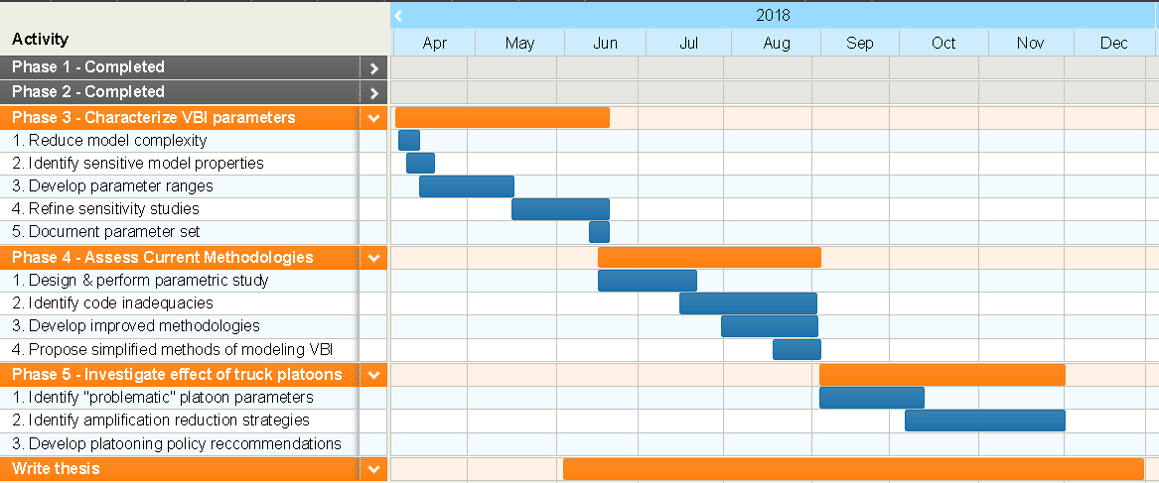
Future Work - Schedule

Slide 43
Future Work: Summary
Perform sensitivity studies to identify parameters and mechanisms that affect VBI.
Perform parametric study to characterize the influence of various parameters on actual dynamic amplification compared to current specified factors.
Perform parametric study to identify situations for which truck platoons result in large structural response.
Phase 3
Phase 4
Phase 5

Slide 44
End
Understanding Vehicle-Bridge Interaction through Field Measurements and Model-Based Simulations
John Braley

Slide 45
Research Strategy
Demonstrate Comprehensive Understanding of VBI
Phase 1 – Identify and characterize “test” structure through field testing. Develop FE model.
Phase 2 – Perform detailed characterization of VBI on test structure. Refine FE model.
Phase 3 – Investigate VBI mechanisms with sensitivity analysis of FE model parameters
Phase 4 – Assess capability of established methods to predict dynamic amplification with FE parametric studies
Phase 5 – Characterize vulnerability of bridges exposed to platooned trucks with FE parametric studies
Develop Actionable Knowledge of Live Load Demands

Slide 46
Objectives
Characterize the mechanisms behind VBI
Role of influential parameters
Identify any shortcomings with current design and assessment methodologies
In which situations are their treatment of dynamic amplification inadequate
Propose modifications
Identify bridge vulnerabilities associated with truck platooning
“Problematic” platoon patterns and vulnerable bridges
Make recommendations related to implementation strategies and policies
Notes:
Difference from previous studies:
Field testing and model calibration will ensure the models are capable of simulating VBI
All influential parameters will be examined simultaneously
Develop actionable conclusions

Slide 47
Background – Vehicle Bridge Interaction
Two dynamic systems
Energy transfer at wheel contact
Motion of one system influences other
Computationally expensive analysis
Highway bridges -amplification factors
m
m
m
m
m
m
VS

Slide 48
State of the Art – Dynamic Amplification
Dynamic Amplification Factors in Codes
Applied to loading model
Developed through survey of existing bridge stock
AASHTO: road roughness – 0.1 to 0.3
Canada/MTO: no. axles – 0.25 (3 or more)
China: 1st natural freq. – 0.05 to 0.40
New Zealand: span length – < 0.30
Europe: span length & no. lanes – 0.1 to 0.3
Japan: span length & bridge type – < 0.35

Slide 49
State of the Art – Dynamic Amplification
Experimental Evaluation
1950’s: AASHTO sponsored testing of 18 bridges
IM dependent on vehicle speed
1956-1957: 52 bridges tested in Canada
IM dependent on road surface irregularities
1958-1981: >200 bridges tested in Switzerland
IM as high as 0.7 for 1st freq. 2-4 Hz.
1980s: 27 bridges tested for OHBDC
High variation in IM’s
Single-subject tests measured IM > code IM

Slide 50
State of Research– Influential Parameters
Vehicle Speed
↑ speed → ↑ DAF
Vehicle Mass
↑ mass → ↓ DAF
Vehicle Suspension
↑ stiffness → ↑ DAF
↑ damping → ↓ DAF
Road Surface Roughness
↑ roughness → ↑ DAF
Span Length
Natural Frequency
Bridge Type
Even though some of these parameters exhibited great influence over dynamic amplification, inconsistent relationships have inhibited revisions to current methodologies.
Poor Correlation

Slide 51
State of the Art – Platooned Vehicles
Lack of research on the effect of platoons on highway bridges
Similar to loading on railway bridges
Large dynamic amplification on railway bridges
Dependent on:
Wheel Spacing
Train Speed
Bridge Span Length
1st Fundamental Frequency (Bridge’s)
Highway bridges are very different from railway bridges

Slide 52
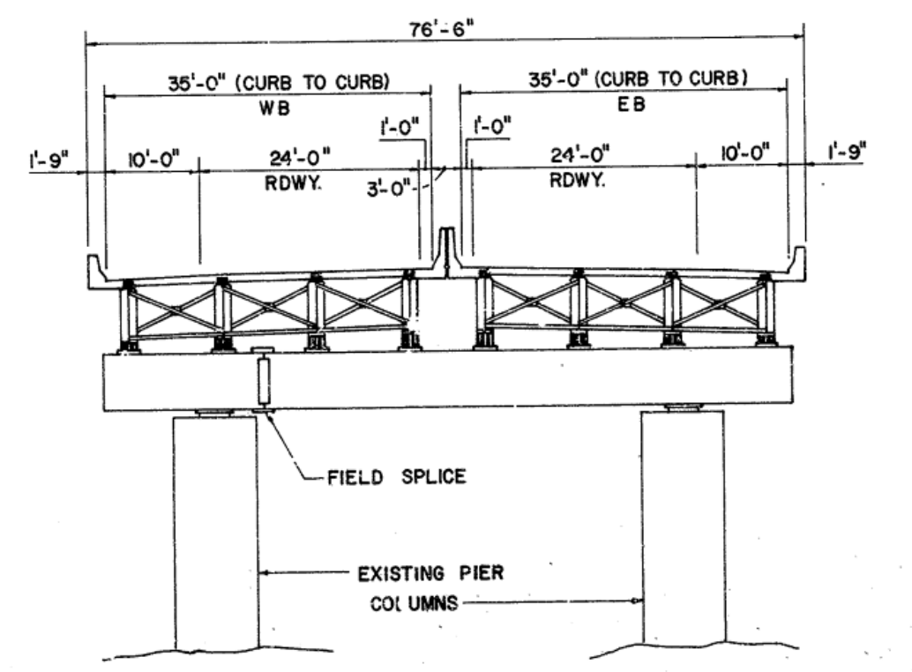


Completed Work – Phase 1
I-76 PENCOYD VIADUCT (1986)
Half section Span 7 and 8
Cross section
Elevation

Slide 53
Future Work – Phase 3: Identification of VBI Parameters
Reduce model complexity
Identify sensitive parameters
Uncertain parameters
Parameters that vary between bridges
Does altering parameter effect solution results
Reduce where appropriate
Develop parameter ranges
Sensitivity studies
Examine and refine parameters and ranges
Regression analysis to identify trends
Combine parameters into a single variable
Address multi-variate/non-scalar parameters

Slide 54
Future Work – Phase 4: Assess Current Methodologies
Design and perform parametric study
Latin hypercube sampling of continuous parameters
Fractional factorial design for categorical parameters
Compute quantities of interest (e.g. DAF) from model results
Identify structures with DAF greater than predicted
Separate samples into “performance” categories
ANOVA to identify important parameters
Regression analysis to better understand effect of parameters

Slide 55
Future Work – Phase 4: Assess Current Methodologies
Identify better methods of predicting amplification factors
Can a simple relationship be identified through regression analysis
Possibly limited to bridge-type
Identify alternative methods of modeling VBI
Simplified model types (e.g. single line or grillage)
Separation of solution
Vehicle Response
Bridge Response

Slide 56
Future Work – Phase 5: Investigation of Truck Platoons
Identify “problematic” platoon parameter values
“Sensitive” models selected from previous study
Parametric study
Vehicle spacing
Vehicle speed
Vehicle suspension stiffness & damping
Trends in maximum bridge response and maximum dynamic amplification
Check trends against other models

Slide 57
Future Work – Phase 5: Investigation of Truck Platoons
Identify “best-case” platoon parameters
Parameters that are under operational control
Previous parametric study data reused
Develop ideal range of parameters
i.e. How can an operator mitigate dynamic amplification
Develop truck platooning policy recommendations

